Slide 1
Integration across biophysical scales identifies molecular and cellular correlates of person-to-person variability in human brain connectivity
Ng et al.
Nature Neuroscience – October 2024

Slide 2
Research Question
How do molecular processes relate to brain-scale connectivity (in humans)?
Notes:
Catholic nuns, priests, and brothers aged 65 years and older from across the United States
Rush University
https://www.rushu.rush.edu/research-rush-university/departmental-research/rush-alzheimers-disease-center/rush-alzheimers-disease-center-research/epidemiologic-research/religious-orders-study

Slide 3
Main Approach
Work with data from multiple biological levels.
Notes:
Catholic nuns, priests, and brothers aged 65 years and older from across the United States
Rush University
https://www.rushu.rush.edu/research-rush-university/departmental-research/rush-alzheimers-disease-center/rush-alzheimers-disease-center-research/epidemiologic-research/religious-orders-study

Slide 4
ROSMAP DATA
Religious Orders Study and Rush Memory and Aging Project (ROSMAP)
Participants are ~1,200 older Catholic clergy who have agreed to annual medical and psychological evaluation and brain donation after death.
A primary goal of the study is to study brain aging and cognitive decline.
Notes:
Catholic nuns, priests, and brothers aged 65 years and older from across the United States
Rush University
https://www.rushu.rush.edu/research-rush-university/departmental-research/rush-alzheimers-disease-center/rush-alzheimers-disease-center-research/epidemiologic-research/religious-orders-study

Slide 5
Multimodal Brain Data
98 ROSMAP participants
Avg. age at scan: 88
Avg. age at death: 91
Avg. postmortem interval (PMI): 8.5h
77% female
Notes:
Both age and death avg age includes tolerance of +/- 6 years
15 +/- 3 years of education

Slide 6
Multimodal Brain Data
Antemortem
Resting-state fMRI
Postmortem
Tandem mass tag mass spectrometry (proteins)
Widefield microscopy (dendritic morphology)
Notes:
Both age and death avg age includes tolerance of +/- 6 years
15 +/- 3 years of education

Slide 7
Regions of Interest
Scan data divided into 100 parcels.
BOLD signal time series within each parcel was averaged.
Pearson’s R was calculated between all parcels, for each participant.
Notes:
Both age and death avg age includes tolerance of +/- 6 years
15 +/- 3 years of education

Slide 8
Regions of Interest
Superior Frontal Gyrus (SFG)
Inferior Temporal Gyrus (ITG)
Notes:
Both age and death avg age includes tolerance of +/- 6 years
15 +/- 3 years of education

Slide 9
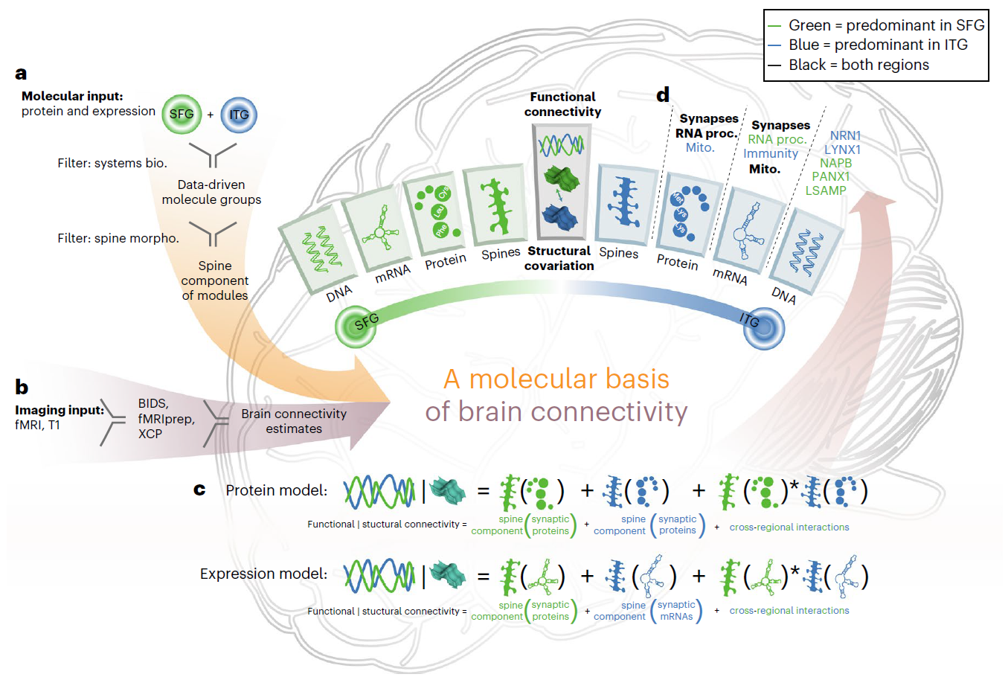
Fig. 1
Notes:
Both age and death avg age includes tolerance of +/- 6 years
15 +/- 3 years of education

Slide 10
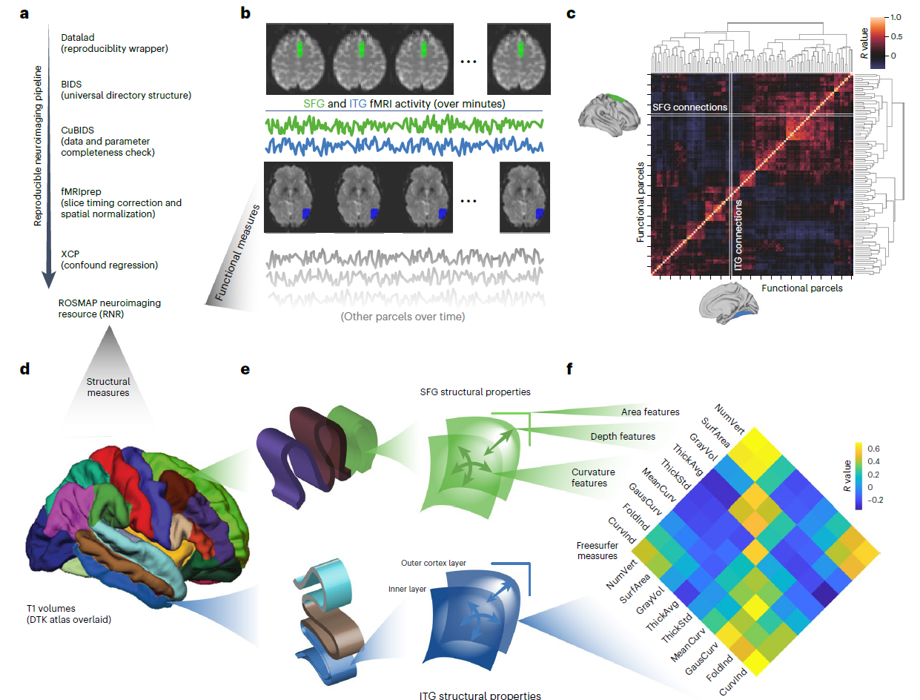
Fig. 2
Notes:
Molecular measurements were then used to predict functional connectivity and structural covariance

Slide 11
Molecular Systems Analysis
7,788 proteins were measured using TMT-MS.
Then clustered into co-abundance modules using SpeakEasy2
The protein covariance matrices were labeled based on highly-enriched Gene Ontology terms.
Notes:
tandem mass tag mass spectrometry (TMT-MS)

Slide 12
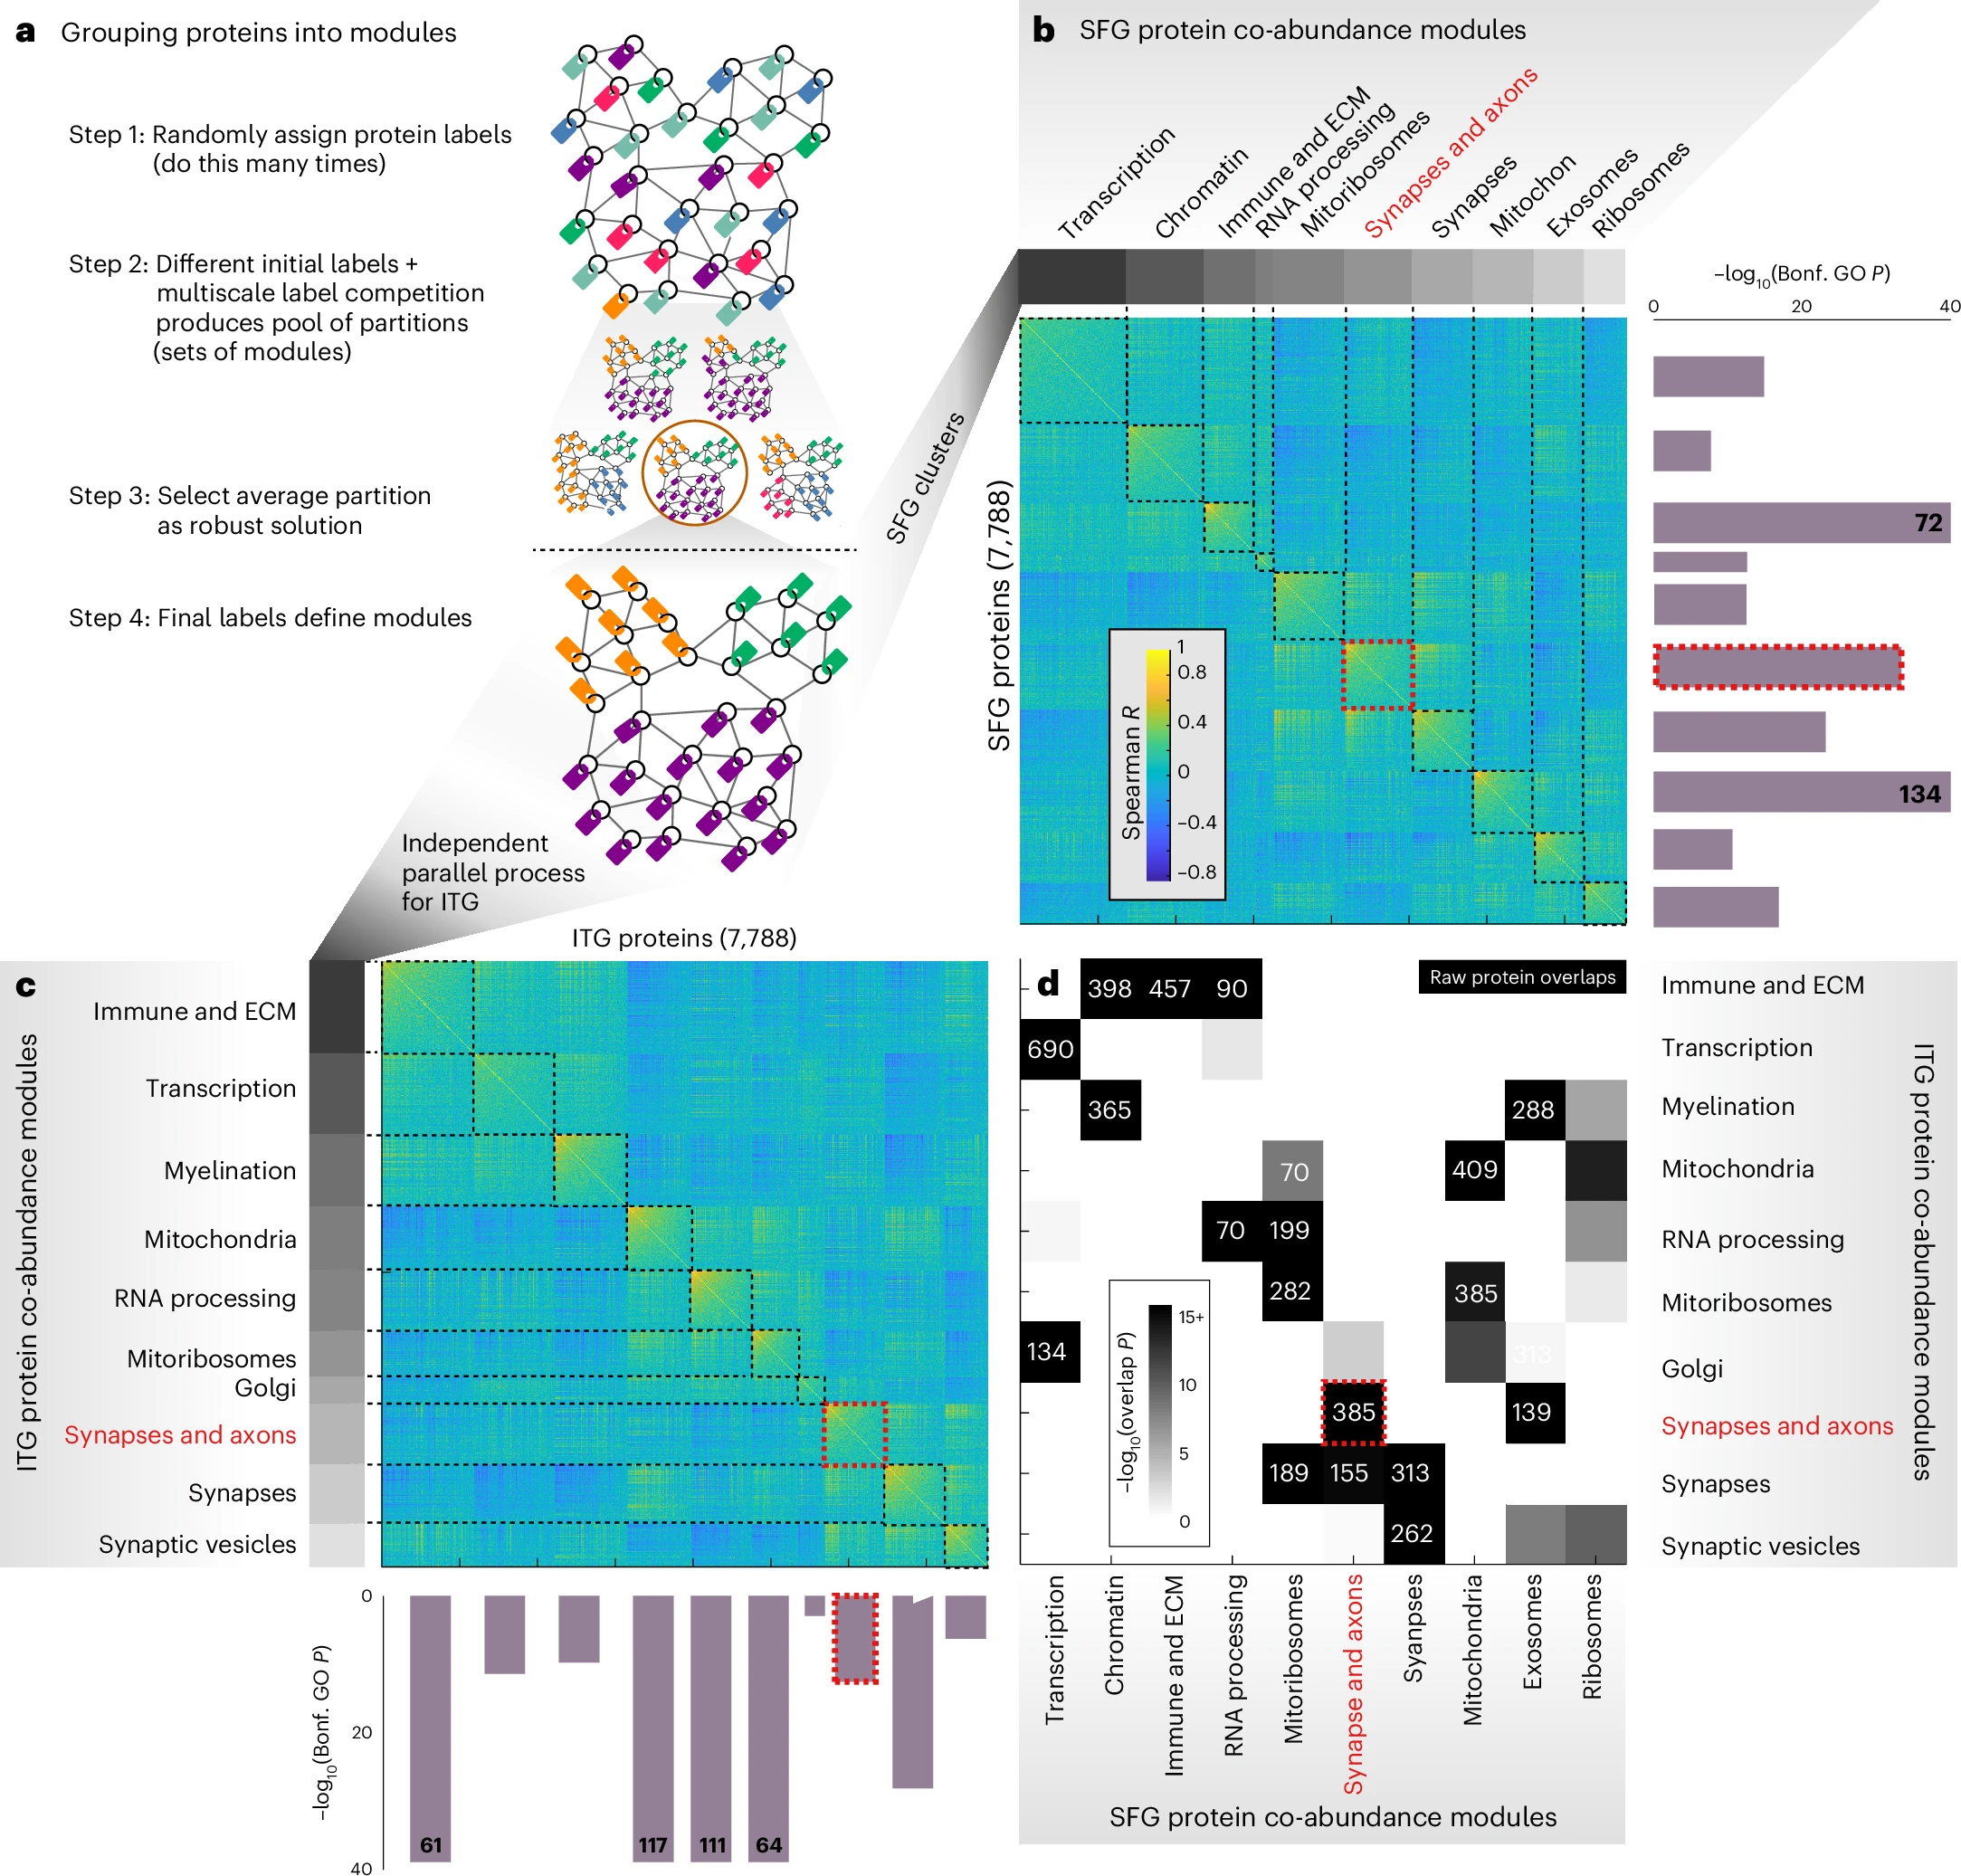
Fig. 3
Notes:
SFG proteins arranged by their assigned module. Protein pairs within
the same module (bounded by dashed squares) display a higher correlation
than protein pairs belonging to separate modules. A short functional label was
assigned to each module (‘transcription’, ‘chromatin’, etc.) based on its more
highly enriched GO terms.
Most modules in one region have one or more highly overlapping modules in the other
region (number of overlapping proteins shown in white text when −log10(P) > 14),

Slide 13
FC Prediction Using Synaptic Expression Module
SFG-ITG connectivity was not associated with synaptic expression modules (P = 0.0532)
Nor were any individual proteins significantly predictive.
However, adding cellular context helped…
Notes:
Both age and death avg age includes tolerance of +/- 6 years
15 +/- 3 years of education

Slide 14
Dendritic Spine Morphology
Dendritic spines are protrusions along neuronal dendrites.
Support the majority of excitatory synapses.
Thin, mushroom, stubby and filopodia.
Notes:
Both age and death avg age includes tolerance of +/- 6 years
15 +/- 3 years of education

Slide 15
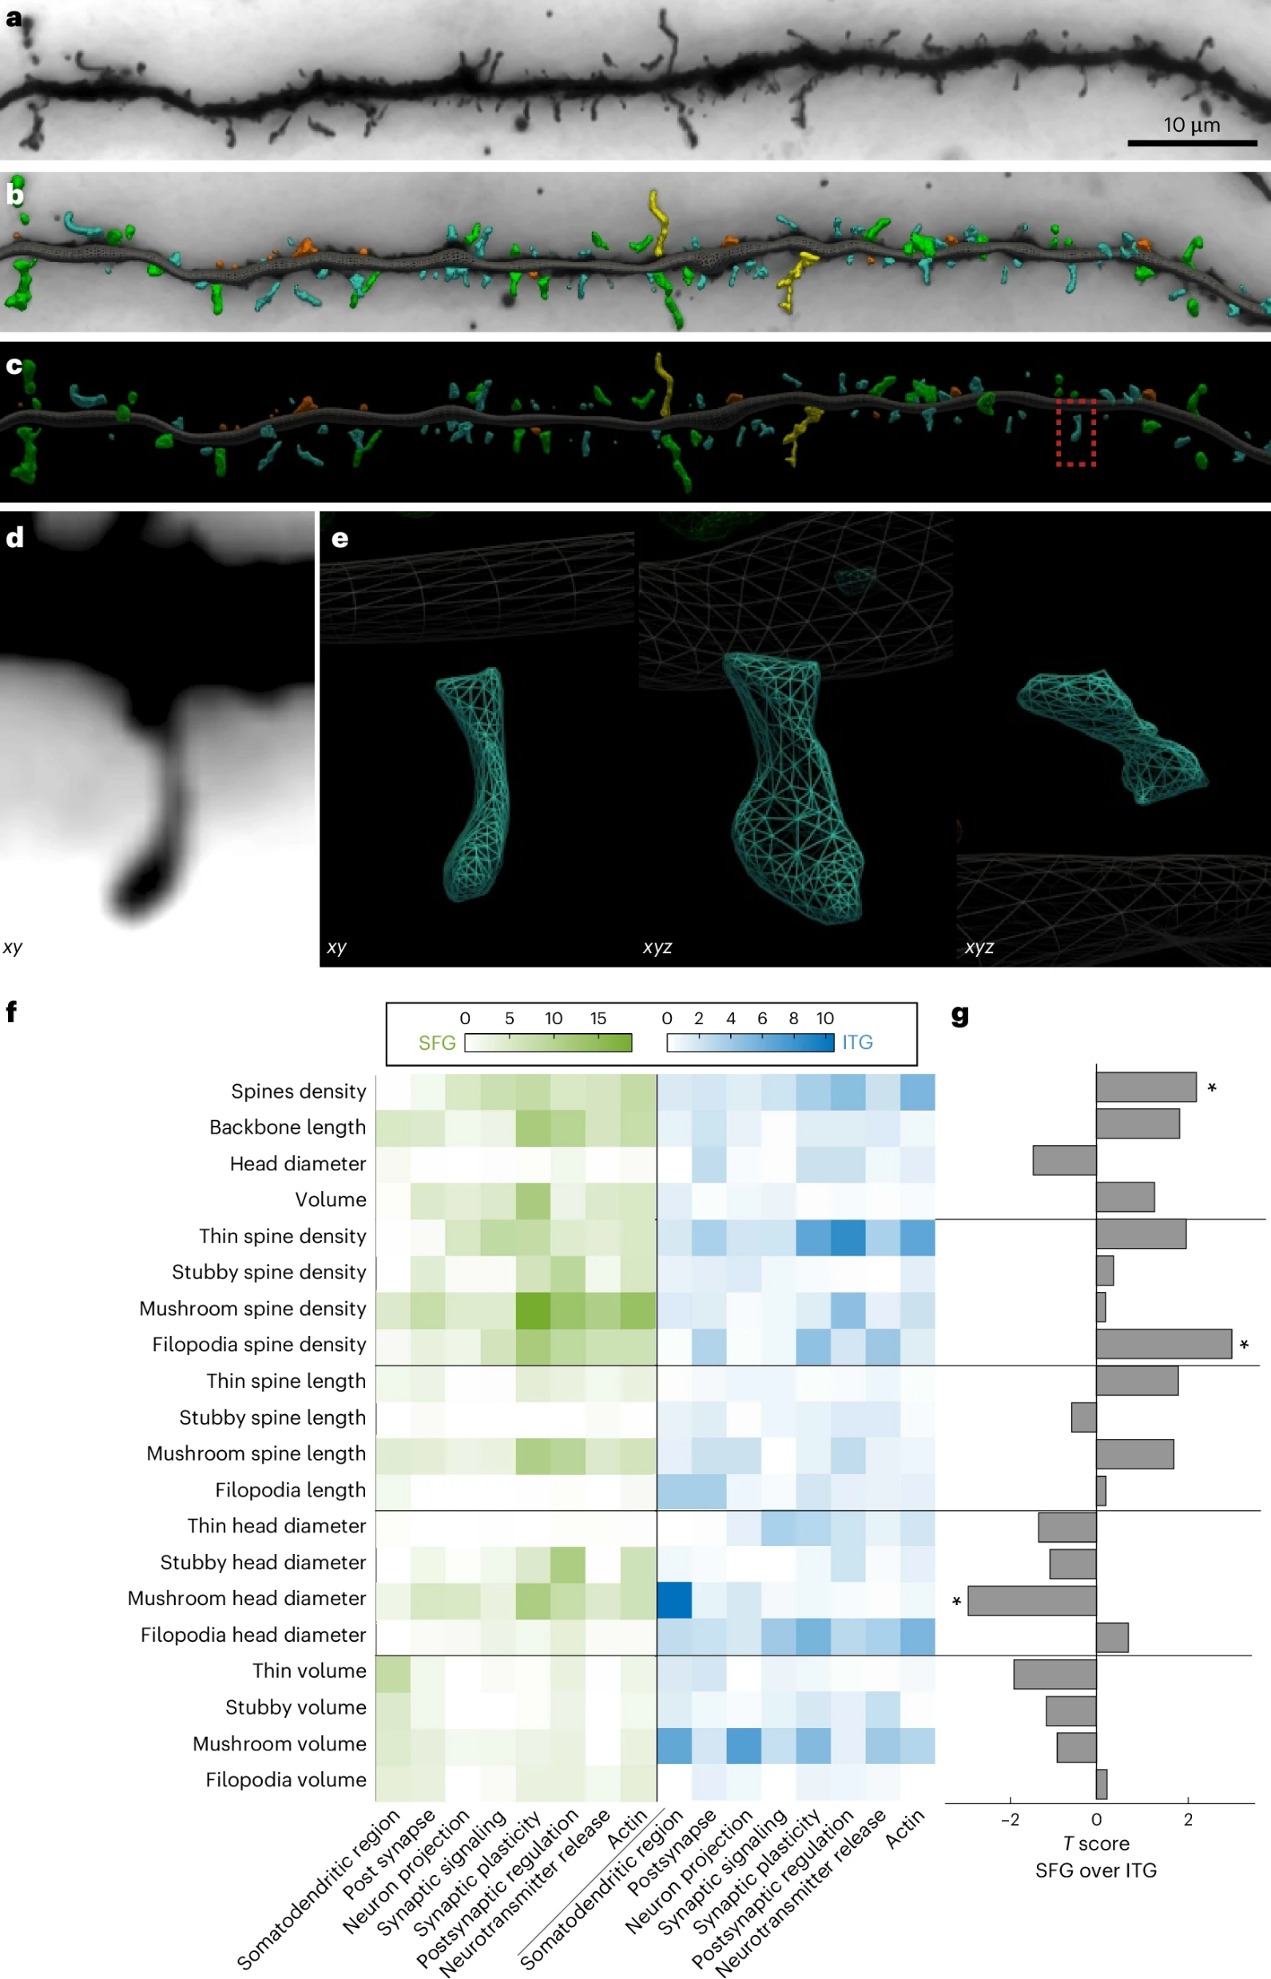
Fig. 4
Notes:
Digital 3D reconstruction used for estimating spine density and morphometric
attributes, including head diameter, length and volume, and assigning
subclasses. Blue indicates thin spines, green indicates mushroom spines,
red indicates stubby spines and yellow indicates filopodia

Slide 16
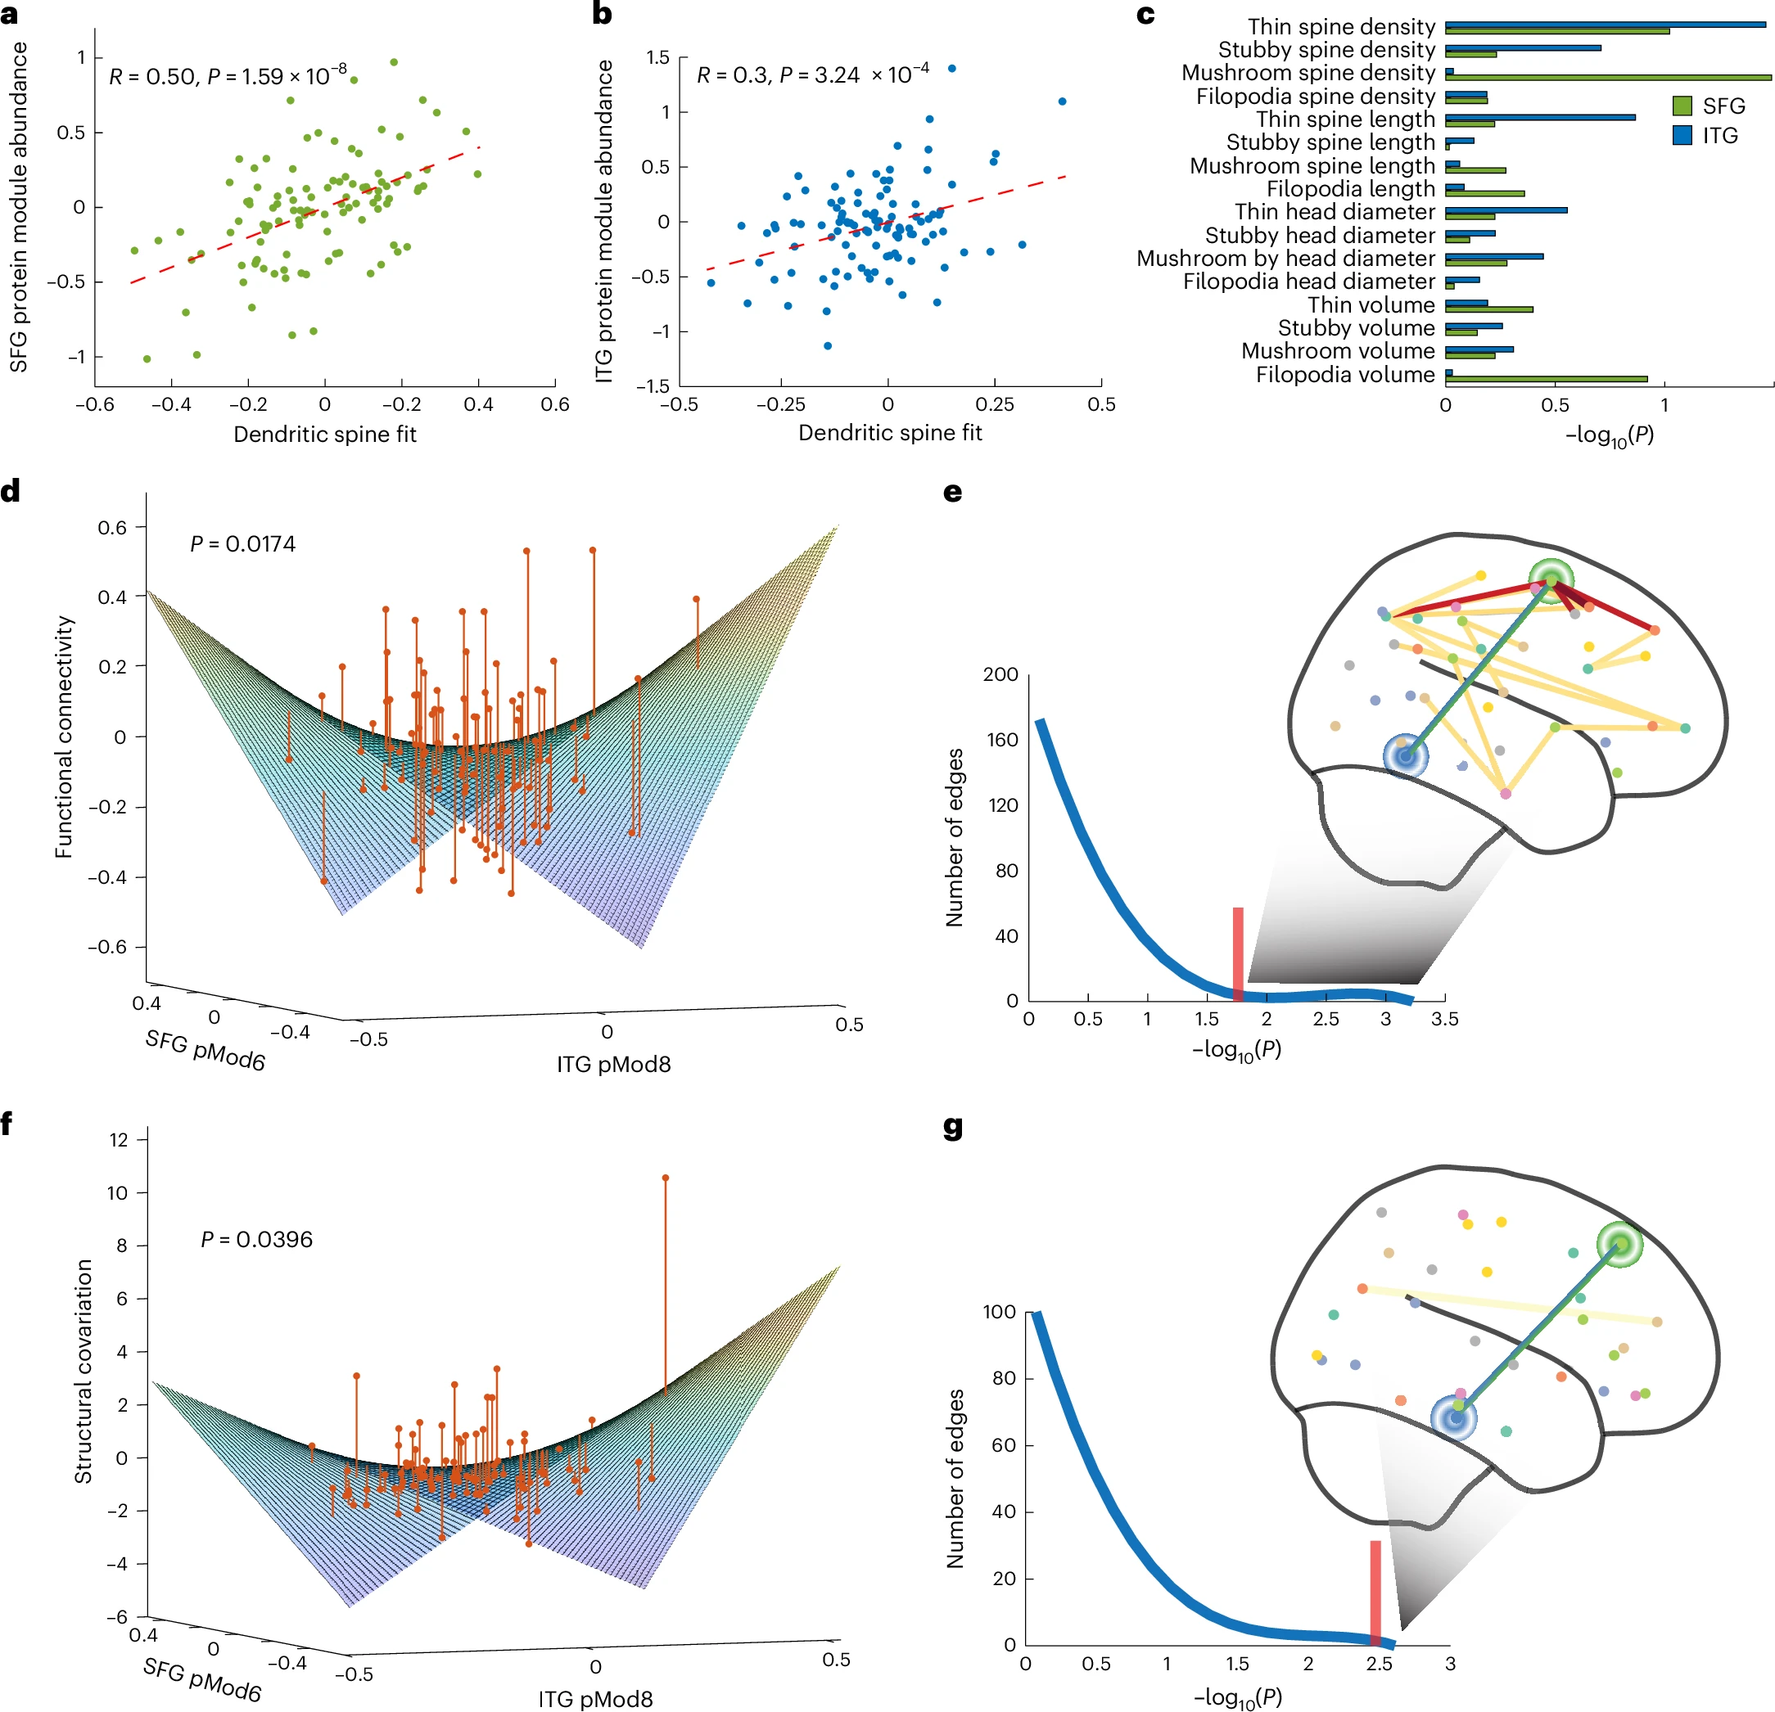
Fig. 5
Notes:
a, Protein abundance of SFG synaptic module plotted against its dendritic spine
fit. Each dot corresponds to an individual and the red dashed line corresponds
to the linear fit between protein abundance and the dendritic spine fit values of
the individuals.
c, Partial contribution of each attribute
toward the dendritic spine fit.

Slide 17
Fig. 5
Notes:
Functional connectivity (with confounds
regressed out) fitted by the dendritic spine component of SFG and ITG synaptic
protein modules. Each red dot corresponds to the functional connectivity
value of an individual with the red line visualizing how far it is from the fitted
surface. The large curvature indicates a strong interaction effect of the modules
on functional connectivity
The Histograms:
X-axis: Represents -log10(P) values of the associations
Y-axis: Shows the number of edges (connections) at each association strength level
The shape represents the distribution of association strengths across all brain region pairs tested
The Red Vertical Line:
Represents the -log10(P) value for the SFG-ITG connection specifically
In Fig 5e (functional connectivity): P = 0.0174 (-log10(P) ≈ 1.76)
In Fig 5g (structural covariation): P = 0.0034 (-log10(P) ≈ 2.47)
The line serves as a reference point to show how many other connections had stronger (to the right) or weaker (to the left) associations
The scattered dots above show the actual connections:
Each dot represents a specific region-pair connection
Their x-position aligns with their association strength
Red dots = connections involving SFG or ITG
Yellow dots = connections between other regions

Slide 18
Protein Modules covary with FC (maybe)
Protein modules were reasonably predictive of ITG-SFG connectivity
They were not generalizable to connectivity across the brain.
Notes:
Both age and death avg age includes tolerance of +/- 6 years
15 +/- 3 years of education

Slide 19
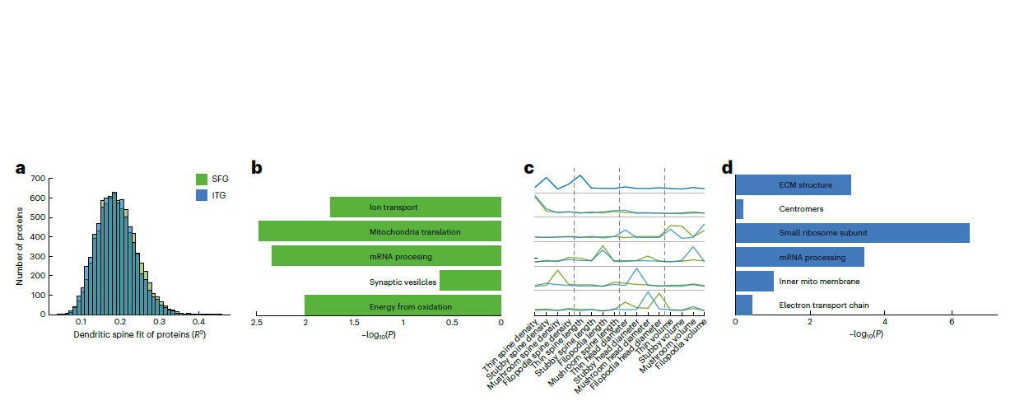
Fig. 6
Notes:
Shows how well dendritic spine attributes predict protein abundance
X-axis: R² values of these "dendritic spine fits"
Y-axis: Number of proteins
Shows distributions for both SFG (green) and ITG (blue)
Key finding: 99% of proteins had R² > 0.1, meaning spine morphology explains some variation in most proteins
Figure 6b & 6d:
Show protein clusters based on how they relate to spine attributes
Each cluster is labeled with its main function based on GO terms
The -log10(P) values indicate how significantly these clusters overlap with proteins associated with functional connectivity
6b shows SFG clusters
6d shows ITG clusters
Figure 6c:
Shows which spine attributes were most important for each cluster
Y-axis lists all spine measurements (density, length, head diameter, volume for each spine type)
Color intensity shows the partial R² - how much each attribute contributed to predicting protein levels
Shows this for both SFG (green) and ITG (blue)
Reveals different clusters of proteins are predicted by different spine attributes
The patterns were aligned between regions using Hungarian clustering

Slide 20
Key Findings
Direct protein-connectivity relationships weren’t statistically significant.
Dendritic spines provided critical context for molecular analyses.
Relationships between molecular abundances and brain connectivity have substantial regional specificity
“Spine Component” analyses identified proteins involved in:
Synaptic function
Energy metabolism
RNA processing
Notes:
Both age and death avg age includes tolerance of +/- 6 years
15 +/- 3 years of education

Slide 21
Questions?
Was this cool?
Any utility beyond age-related medicine?
What do we think about generic datasets?
Notes:
Both age and death avg age includes tolerance of +/- 6 years
15 +/- 3 years of education

Slide 22
What Is The BOLD signal?
Is it biased toward LFP rather than multi-unit activity?
Is LFP biased toward incoming signals?
Notes:
The relationship between BOLD and neural activity is complex, with several leading interpretations:
Local Field Potentials (LFPs):
Many studies suggest BOLD correlates strongly with LFPs, particularly in the gamma band (30-80 Hz)
This correlation is often stronger than with action potentials/spikes
The relationship makes sense mechanistically since LFPs reflect integrated synaptic activity in a local area, which drives metabolic demand
Input/Synaptic Activity:
BOLD may primarily reflect incoming synaptic activity rather than output spiking
This includes both excitatory and inhibitory postsynaptic potentials
The energetic costs of synaptic transmission drive blood flow changes
Neurometabolic Coupling:
BOLD reflects local changes in blood oxygenation and flow
These changes occur in response to increased metabolic demands from neural activity
There's a complex cascade: neural activity → metabolic demand → vasodilation → blood flow changes → BOLD signal

